Slide 1
Packet Monkeys

Slide 3
What are packets?
How information travels on networks
Take your data, put it in a packet
Network devices (switches, access points, routers) know what to do with packets

Slide 4
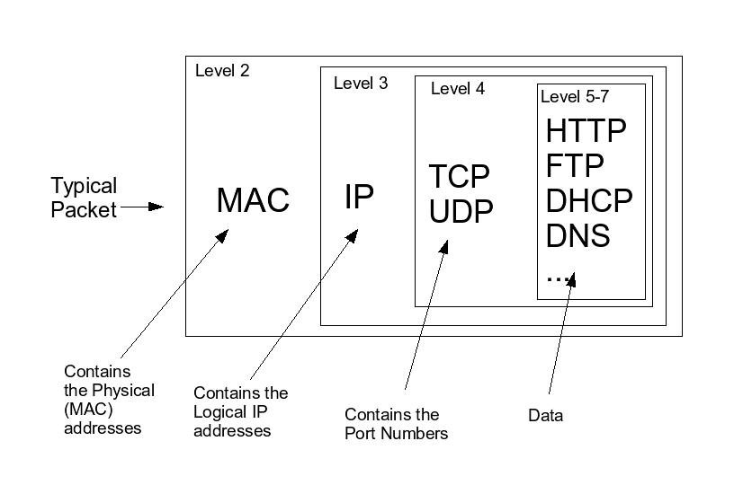

Slide 5
|0 |08|81|f4|44|7b|30|98|fe|94|40|1a|8c|08|00|45|00|02|4a|b7|12|40|00|40|06|8a|93|c0|a8|0a|6e|4a|7d|e1|74|cb|ce|00|50|49|68|bb|a3|20|d3|5d|a8|80|18|20|32|21|dc|00|00|01|01|08|0a|3e|96|00|f7|67|7a|3b|a4|47|45|54|20|2f|63|73|65|2f|73|74|79|6c|65|2f|6c|6f|6f|6b|2f|64|65|66|61|75|6c|74|2e|63|73|73|20|48|54|54|50|2f|31|2e|31|0d|0a|48|6f|73|74|3a|20|77|77|77|2e|67|6f|6f|67|6c|65|2e|63|6f|6d|0d|0a|55|73|65|72|2d|41|67|65|6e|74|3a|20|4d|6f|7a|69|6c|6c|61|2f|35|2e|30|20|28|4d|61|63|69|6e|74|6f|73|68|3b|20|49|6e|74|65|6c|20|4d|61|63|20|4f|53|20|58|20|31|30|2e|39|3b|20|72|76|3a|32|37|2e|30|29|20|47|65|63|6b|6f|2f|32|30|31|30|30|31|30|31|20|46|69|72|65|66|6f|78|2f|32|37|2e|30|0d|0a|41|63|63|65|70|74|3a|20|74|65|78|74|2f|63|73|73|2c|2a|2f|2a|3b|71|3d|30|2e|31|0d|0a|41|63|63|65|70|74|2d|4c|61|6e|67|75|61|67|65|3a|20|65|6e|2d|55|53|2c|65|6e|3b|71|3d|30|2e|35|0d|0a|41|63|63|65|70|74|2d|45|6e|63|6f|64|69|6e|67|3a|20|67|7a|69|70|2c|20|64|65|66|6c|61|74|65|0d|0a|44|4e|54|3a|20|31|0d|0a|52|65|66|65|72|65|72|3a|20|68|74|74|70|3a|2f|2f|77|77|77|2e|64|73|75|2e|65|64|75|2f|0d|0a|43|6f|6f|6b|69|65|3a|20|50|52|45|46|3d|49|44|3d|62|37|65|30|30|36|35|64|63|31|65|34|62|61|62|66|3a|54|4d|3d|31|33|39|31|36|33|33|39|33|39|3a|4c|4d|3d|31|33|39|31|36|33|33|39|33|39|3a|53|3d|43|43|43|72|4d|72|48|76|38|7a|64|6f|30|61|48|58|3b|20|4e|49|44|3d|36|37|3d|56|45|67|42|65|68|70|2d|77|35|72|76|6b|45|57|4b|66|61|6a|41|34|51|33|66|58|31|5a|55|35|72|53|73|38|75|65|59|49|4d|6f|76|56|49|65|79|53|42|45|4a|52|39|61|32|4e|62|77|65|51|65|74|67|56|70|57|41|5a|33|62|44|4f|36|6f|5f|30|74|54|62|5a|75|6c|4f|62|74|31|65|5a|5f|48|34|31|57|73|55|52|75|64|57|68|49|5f|51|39|49|7a|64|30|72|44|66|39|39|47|6b|49|34|30|39|34|37|6c|39|32|32|36|62|73|4b|4b|63|0d|0a|43|6f|6e|6e|65|63|74|69|6f|6e|3a|20|6b|65|65|70|2d|61|6c|69|76|65|0d|0a|0d|0a|

Slide 6
That sucks

Slide 7
What to do instead?
Enter: Protocol Analyzer
Networks are governed by protocols
What are some examples?

Slide 8
Wireshark
One of the most common protocol analyzers
Here’s one way Wireshark visualizes packets:
Why would we ever do this?

Slide 9
Because Shit Breaks
Why doesn’t my internet work?
Is this router broken?
Why can’t I get to Google?
Did someone hack our server?
Did they copy files from your computer?

Slide 10
Here’s our example

Slide 11
Getting Started: Kali
Kali Linux is on your machines
Let’s make sure you’re on the internet before we play

Slide 12
Lets Try Wireshark
Install/Open/Connect/Rock and Roll
Browse to your favorite website
Log in ←Is this even safe to do?
Let’s try

Slide 13
Why can’t we see your password?

Slide 15
Let’s do an FTP capture
How is FTP different from Gmail/Facebook/etc?
Server: 138.247.151.181
Username: cyberstars
Password: EpicPassword

Slide 16
Wireshark
Sessions, Conversations, etc
Exporting Objects

Slide 17
Wireshark is an in-depth tool
What if I just need to look for files?

Slide 18
Enter: Network Miner
Single purpose tool:
Network forensics
We’ll use a free version
Easily search/extract things from network traffic
Can’t be automated (must pay for it first)

