Slide 1
Yubikey?

Slide 2
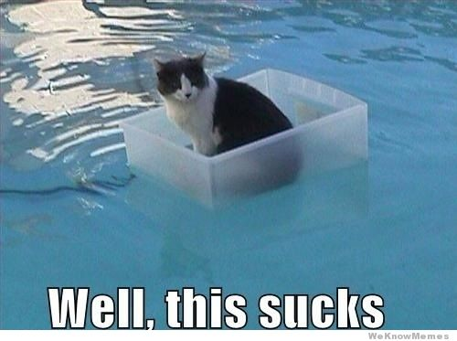
Fact #1: Passwords suck

Slide 3
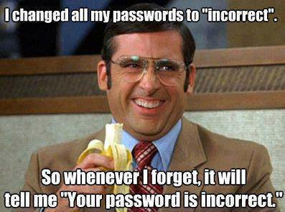
Fact #2: Your passwords probably suck

Slide 4
Fact #3: We have to use passwords (no matter how much they suck)

Slide 5
Multi-Factor Authentication
Basically: Your password + “one more thing”

Slide 6
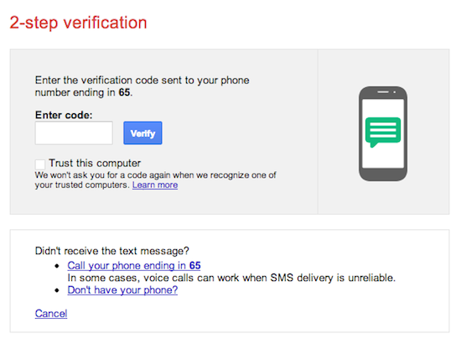

Slide 7
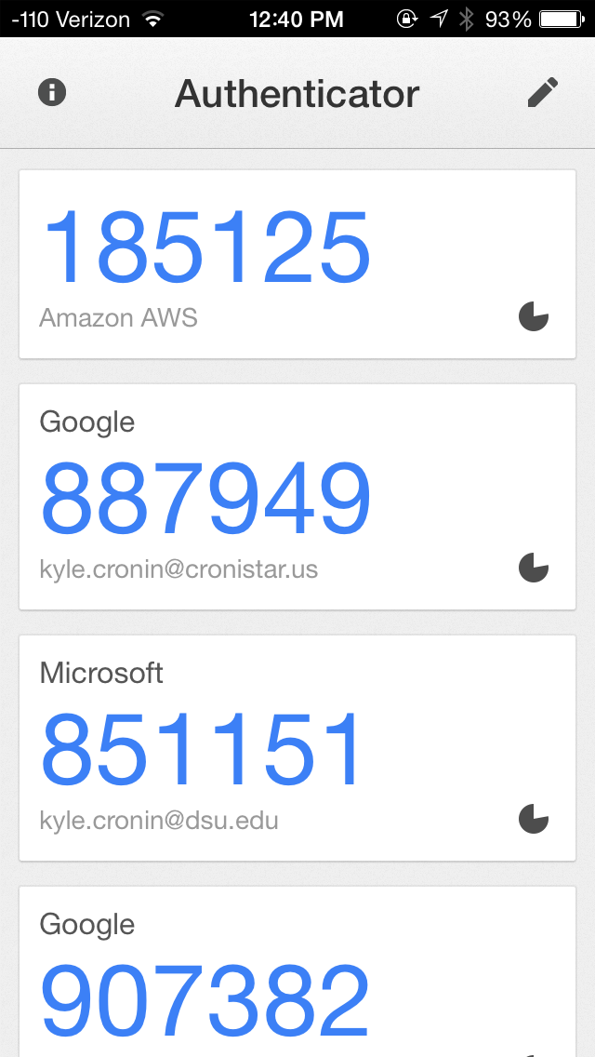

Slide 8
What can do we instead?
2-Factor authentication
Google, Facebook, Twitter, Microsoft
These guys are pretty good at this
Runners up: your bank

Slide 9
What about the rest?

Slide 10
Let’s Write Them Down!
Make an epic password, store it in a file
Can’t be guessed
Passwords like this:
/àfcûPð¸³Æä.g¼Zwspú)PZhíªjÕèªª)ªÃ;X§
Then Copy/Paste it
But… what’s the problem with this?

Slide 11
Enter> YubiKeys
Tiny password keys
Can encrypt files

Slide 12
Install Things
http://Cyberstars.ialab.us
Under the Yubi_Key folder
Grab these files
KeePass-2.27-Setup.exe
OtpKeyProv.zip
yubikey-personalization-gui-3.1.14.exe
Notes:
Install KeePass and the Yubikey Personalization tool

Slide 13
What we need to do
Install the programs
Configure the YubiKey
Add the One-Time-Password Plugin
Setup a password database
Win
Notes:
Inside the YubiKey Personalization tool, select OATH-HOTP for the configuration method
Select configuration slot 1
Deselect OATH Token Identifier
Make sure 8 digits is selected
Deselect Hide Secret, copy it to a text file temporarily
Go to the Settings Tab, choose Tab instead of Enter on the OTP section
Go back to OATH-HOTP, select Write Configuration
Open the OptKeyProv zip file, find the OtpKeyProv.plgx file and copy it to C:\Program Files (x86)\KeePass Password Safe 2\
Open KeePass2
Specify that you want a Master Password, specify your password
Check Key File / Provider and select One-Time Passwords from the drop down
Click Ok
Paste the “Secret” key from your text file into the Secret Key box
Click Ok

