Slide 1
Arduino 101
Val Manes
Department of Math & Computer Science

Slide 2
Download Arduino Software
Link:
http://gencyber.ialab.dsu.edu/2016/Arduino/
Save it to your computer
Execute the file, accept all defaults

Slide 3
Hardware
Microprocessor with hardware interfaces
Digital I/O
Analog I/O
3.3v & 5v supply
Simple programming interface

Slide 4
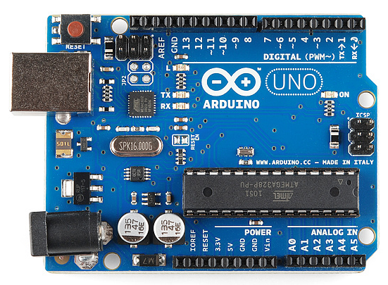
Arduino Uno

Slide 5
Interfaces
Analog
Read varying voltage, convert to number (0-1023)
Light, temperature, distance
Pins A0-A5
Digital
Read on/off state or provide power on/off
Pushbutton, LED, buzzer
Pulse Width Modulation/PWM (pseudo-varying voltage)
Pins D0-D13

Slide 6
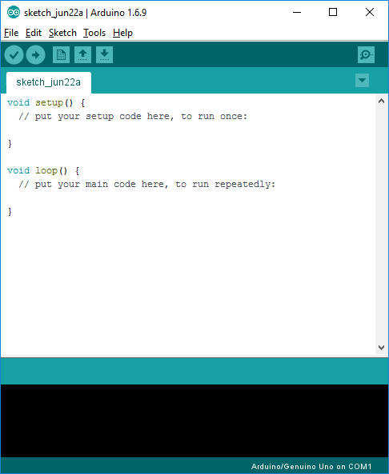
Arduino Integrated Development Environment
Tools to write, compile and execute sketches (programs)
Code is in C language (mostly)
Opening sketch provides default setup and loop functions

Slide 7
Three sections to code
Global variables (constants)
Before the void setup( )
Define values used throughout program
void setup( )
Initialization steps – set pin modes
Executes once at start of program
Set initial state of devices, if needed
void loop( )
Main program execution
Continually repeats

Slide 8
Initial Sketch Code
void setup() {
// put your setup code here, to run once:
}
void loop() {
// put your main code here, to run repeatedly:
}

Slide 9
C Statements
End with semicolon (except branching/loop statements)
Case sensitive
Curly braces { } mark blocks of code
branches, loops, etc.

Slide 10
Data Types
int – integer, whole number: 1 2 9999 -876
float – floating point, real number 1.234 -0.0003456
double if you need greater precision than 7 digits
char – character, a single letter, digit, punctuation
Enclosed in single quotes: ‘a’ ‘1’ ‘#’

Slide 11
Variables
Names of memory spaces
Assign and modify values stored
Declare before use
int total;
float average;

Slide 12
Sample Program – Blink LED
int led = 10;
void setup() {
pinMode( led, OUTPUT );
}
void loop() {
//turn LED on and off for off half second
digitalWrite( led, HIGH );
delay( 500 );
digitalWrite( led, LOW );
delay( 500 );
}

Slide 13
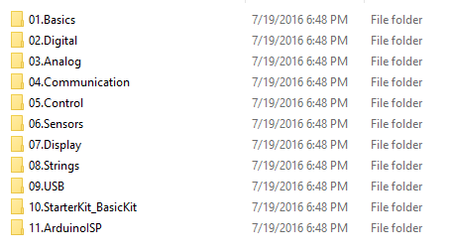
Included Examples
C:\Program Files (x86)\Arduino\examples

