Slide 1
Welcome to Wifi

Slide 2
This morning
You’ve gotten the grand tour
About us
Welcome, getting started, etc
How wireless works

Slide 3
But first
Why talk about how wifi works?
Lets just do l337 hax

Slide 4
On your honor…

Slide 5
B4 the hax
We need to know how this stuff works

Slide 6
Linux??

Slide 7
A Tail of 2 Addresses
MAC Address:
Like your name
Given when made
IP Address
Like your mailing address
Might change from time to time

Slide 8
How they’re different
MAC Addresses
a8:96:8a:f1:ff:c6
First part = manufacturer
“Can’t be changed”
But it can be spoofed
Allows communication to your neighbor
Like a router
Can’t talk outside your network
IP Addresses
192.168.10.5
Changes all the time
Lets you communicate outside your network

Slide 9
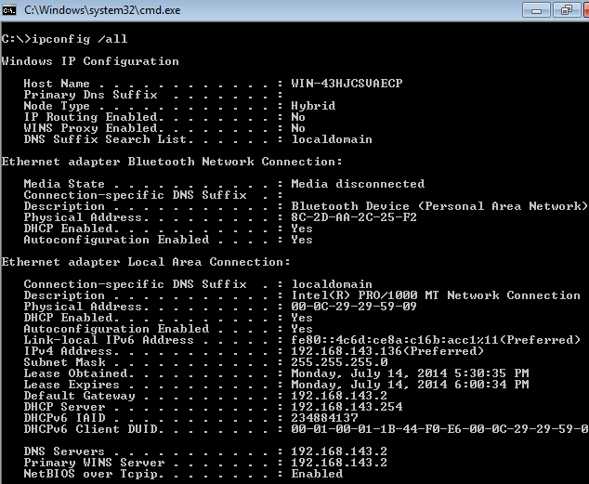
Notes:
How to find your mac address under windows. This screenshots shows the MAC address for the network and Bluetooth adapter circled in red.
The IP address for the network adapter is circled in yellow.

Slide 10
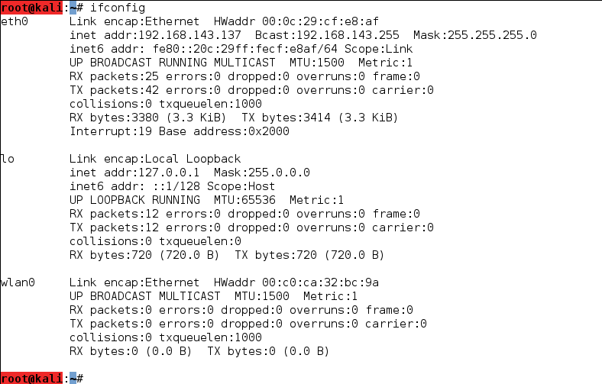
Notes:
The physical network and wireless network adapter’s mac addresses are circled in red. The IP address of the physical Ethernet adapter is circled in yellow.
The wireless adapter isn’t connected to any network, therefore there is no IP address.

Slide 11
ARP
Connect:
IP and MAC
Computer: What is 192.168.1.1’s MAC?
192.168.1.1: I’m a8:91:8a:b2:df:f6
Run: arp -a

Slide 12
Wireless Spectrum
9-100 Khz- Aircraft, ship navigation
100Khz-1Mhz: AM Radio
Around 10 Mhz: Shortwave Radio
Around 100 Mhz: FM Radio
Between FM and 1Ghz: TV
1Ghz: Cell Phones
10 Ghz + WiMax and Satellite

Slide 13
WiFi Goodness
We use radio waves to communicate- duh
Radios transmitting at 2.4 or 5Ghz
Then we separate channels in-between
Why these frequencies?
Who is wifi’s biggest enemy?
Notes:
They’re free frequencies, unlicensed. Initially intended to be used for non-communication purposes
What non-communicating device uses radio waves?

Slide 14
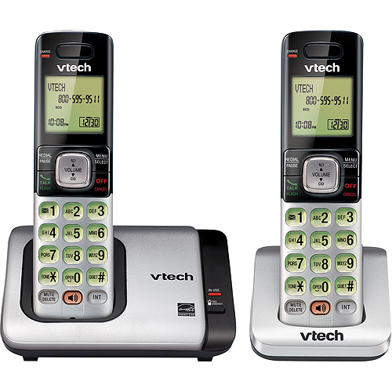
Notes:
These may also use the same frequency and interfere
How can we avoid this?

Slide 15
Frequencies/Channels for 2.4 Ghz

Slide 17
Notes:
Also operate at around 2.4 Ghz
How does wifi work with these around? Usually it does, but if the microwave’s shielding may be weak it can interfere

Slide 18
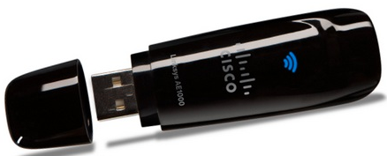
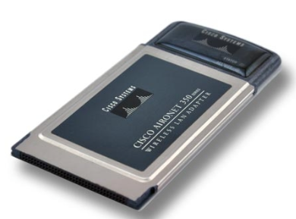
Let’s first talk about wireless cards:

Slide 19
Transmit Power (TX)
How far a card can actually transmit
Usually expressed in milliwatts (mW)
Consumer cards usually are around 30mW (+14.8 dBm)
Professional gear is around 300 mW (+24.8 dBm)

Slide 21
Sensitivity
Often overlooked in favor of TX
What good is it to transmit great distances but not receive a response?
Usually measured in dBM (decibels relative to 1 mW)
The more negative the number, the better for receiving when looking at cards
-90 is better than -86

Slide 22
AP Sensitivity
When you’re looking at how many dBm your access point is, the closer to 0 the better
It’s backwards and a little confusing at first
Buying antenna: -dBm better
AP signal: close to 0 dBm better

Slide 23
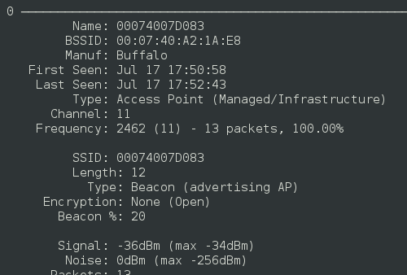
AP Sensitivity

Slide 24
Sensitivity
Typical values are -80 dBm to -90 dBm
Each 3 dBm change represents doubling of sensitivity
High end cards get as much as -93 to -97 dBm
Convert mW to dBm:

Slide 25
Chipset
We won’t spend too much time on this
Essentially what “drives” the card and tells it how to operate
Some chipsets are more hacker friendly than others
Ralink

Slide 26
Antenna Types
Omnidirectional
Extends your range in all directions
Directional
Let’s you focus your signal in a particular direction
Sensitivity – measured in dBi
dBi - gain of an antenna as referenced to an ISOTROPIC (omnidirectional) source
Remember, every 3 dBi = double the sensitivity

Slide 27
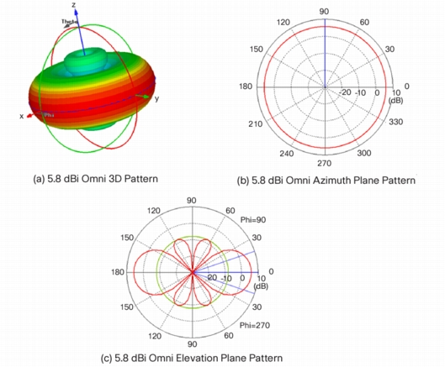
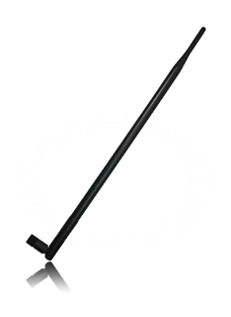
Omnidirectional

Slide 28
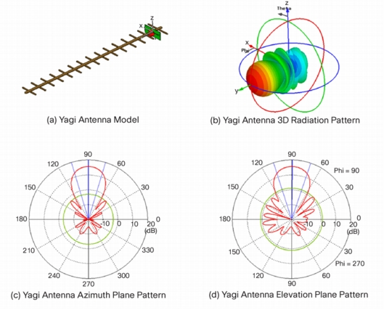

Slide 29
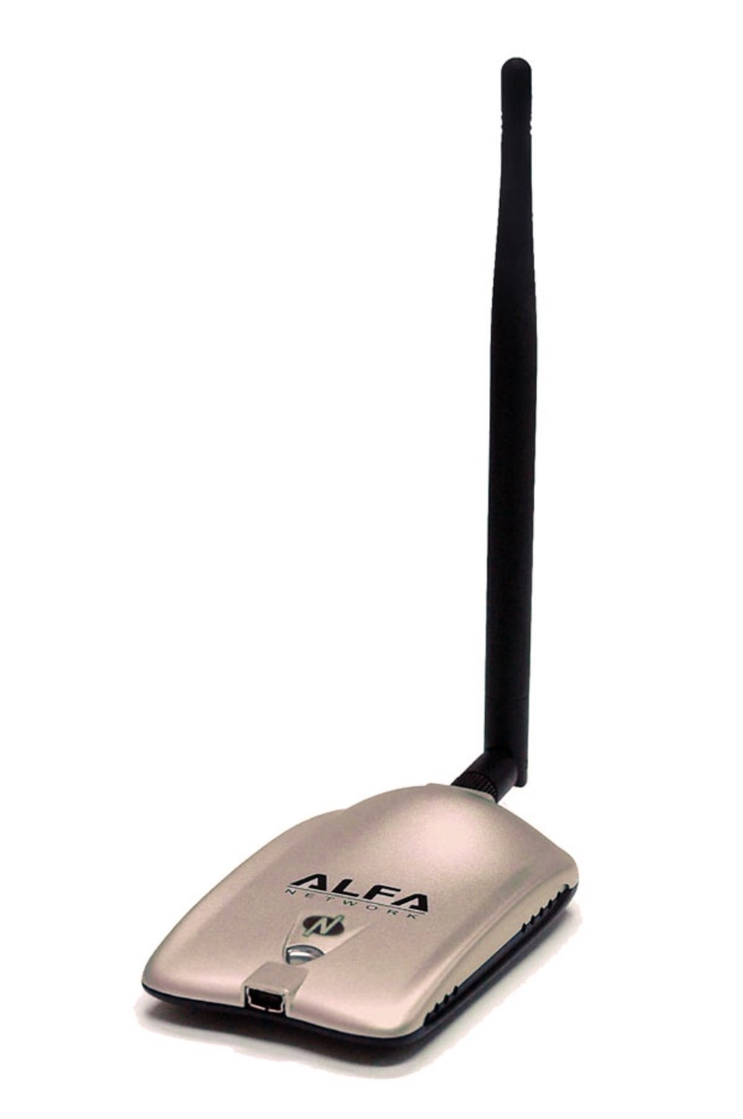
Alfa AWUS051NH
500mW High Gain 802.11a/b/g/n
5dBi and 9dBi omnidirectional antennas
One antenna is a little over double as sensitive (4dB)

Slide 30
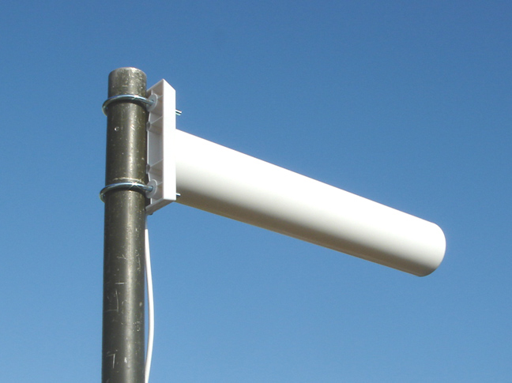
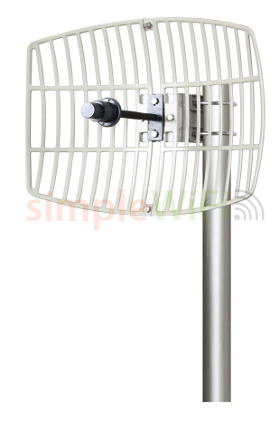
Outdoor Antennas

Slide 31
Cantennas!
People have found ways to modify cans and other cylindrical objects to make homemade directional antennas
They actually work, and some are pretty amusing
http://support.jefatech.com/cantenna/

Slide 32
Pringles Can?

Slide 33
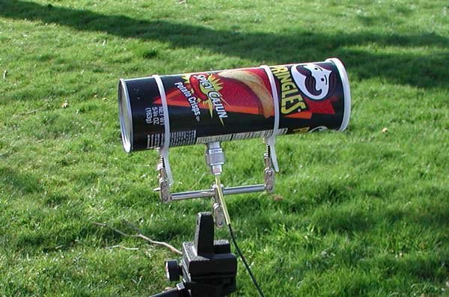
Pringles Cantenna

Slide 34
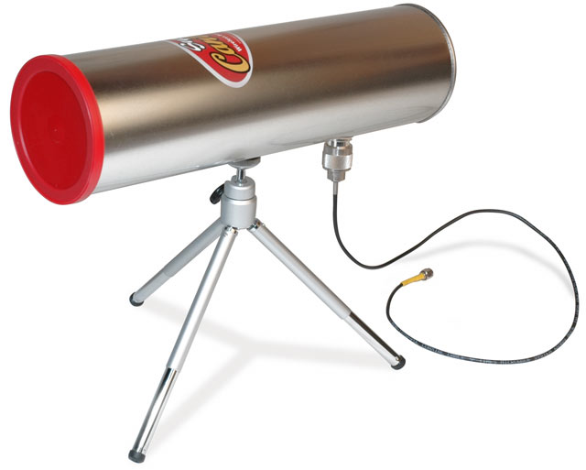

Slide 35
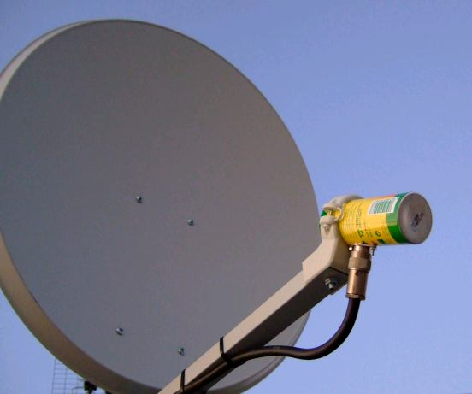

Slide 36
IEEE802.11
We know: B, G, A, N, AC -> Right?
B: Old and slow, 2.4 Ghz
A: Not many use, 5Ghz!!
G: Not as old or as slow as B, 2.4 Ghz
N: Pretty good, fast, etc, 2.4 or 5 Ghz!
AC: Real nice 5Ghz!!

Slide 37
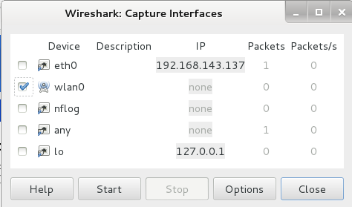
Watch wireless connect
Open Wireshark
Applications>Internet>Wireshark
Select wlan0, click Start

Slide 38
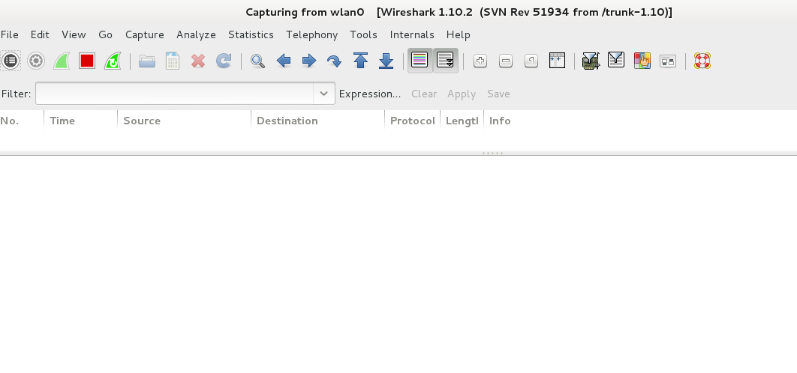
And…. Nothing Happens…
Notes:
Right now, your adapter is playing by the rules. Its only listening to the traffic that’s being sent to it… There is no traffic being sent to it, so there is nothing to display.

Slide 39
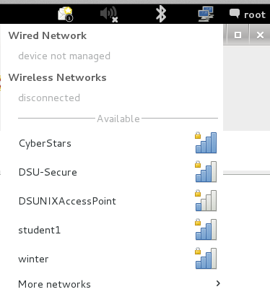
Connect to a Network
Network Manager >
Select your network

Slide 40
Listening to yourself isn’t much fun

Slide 41
airmon-ng
Enables monitoring of wireless interfaces
Forces your adapter into “monitor” mode
Basically: creeper mode

Slide 42
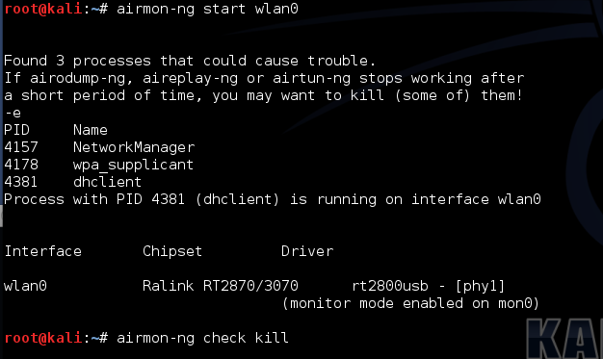
Notes:
Running airmon-ng by itself will list all of the current wifi adapters and tell you if any monitors exist
Airmon-ng check kill will find all of the programs that are using the wireless adapter and kill them off

Slide 43
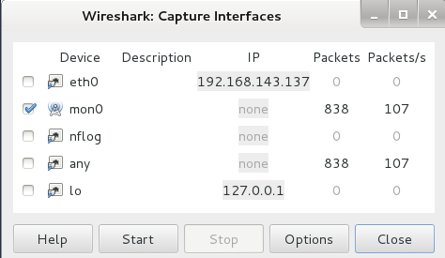
Watch wireless connect
Open Wireshark
Applications>Internet>Wireshark
Select mon0, click Start

Slide 44
Problem
Your Routers/APs spill all of their details...
Broadcast TONS of info that we LOVE to have!
BSSID: Basic service set identification
Contains: SSID and MAC Address
SSID: Service Set Identifier
MAC: Your hardware address
What if we hide this info??
Notes:
You can’t hide it!!!
You can hide the SSID

