Slide 1
Passwords
Turn on your Kali VMs
DSU GenCyber

Slide 2
Security Controls
What is the main thing preventing me from accessing your _____ account?

Slide 3
Security Controls
What is the main thing preventing me from accessing your _____ account?
A Password!!!
If this is the only thing stopping an attacker from breaking in…
They’re going to poke at it a bunch
We probably need to make them as good as we can

Slide 4
Passwords
How good are your passwords?
What makes a secure password?

Slide 5
Passwords
How good are your passwords?
What makes a secure password?
Length?
Complexity?
Both?

Slide 6
How Do Passwords Work?
Simply…
Set your password – website stores it
Log in – website compares with stored password
Easy enough…
But what’s wrong?

Slide 7
Password Storage
What if a database is compromised?
Dump all users passwords – in plaintext!!!
https://haveibeenpwned.com/
Emails
Passwords

Slide 8
Better Password Storage
Instead of storing plain text…
Store some other representative thing
Not the password itself
Make it impossible to learn the password
One-way hash
Now…
Set your password – website hashes it, stores the hash
Log in – website hashes your submission, compares it with stored hash

Slide 9
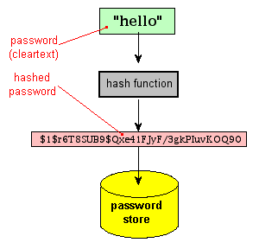
One-way Hash Function
Maps an arbitrary size of data to a fixed size of data
Fairly easy to compute an output given an input
Must be difficult to go the other way
Plaintext -> Hash ✔
Hash -> Plaintext ✖️

Slide 10
Hashing Example
In Kali…
echo –n “password” | md5sum
Some hashing algorithms…
MD5
Can fairly quickly compute collisions
SHA-1
http://shattered.io
SHA-2 family
SHA-256
Bcrypt
Specifically for hashing passwords
Sample hashes: http://openwall.info/wiki/john/sample-hashes

Slide 11
Cracking Passwords
Process of going from a hashed password to plaintext
Shouldn’t be easy – and with strong algorithms, it isn’t easy
We must create a hash to compare against.
We compare, when it matches, we found the password
Our hash = “FSDglG0(*hSDF21wkDSF8vsw7”
“Baseball” → “7Ce1qlkjgt1gdbADFg124d”
“Password” → “1lkG90iD09igfds980ASFD”
“d0g” → “FSDglG0(*hSDF21wkDSF8vsw7”
MATCH FOUND!

Slide 12
Two Methods…
Dictionary Attack
Uses a list of words (dictionary) to try
Fast, but the password MUST be on the list for success
Brute Force Attack
No preconfigured list
aaaa
aaab
aaac
…and so on
Slower, but, given enough time, you’ll get the correct password

Slide 13
Building a Dictionary
Commonly used passwords
Examples?
Dumps from previous breaches
Default passwords
admin
password
Summer2019
Summer2019!
Common character substitutions
E becomes 3
O becomes 0
I becomes 1

Slide 14
John The Ripper
Free, open source password cracker
Primarily meant to detect weak passwords
Included on Kali
john
Has a small word list
/usr/share/john/password.lst
More lists in Kali
/usr/share/wordlists

Slide 15
Let’s Try It
First, make your password hash, save it in a file
echo -n “chicken” | sha256sum
Throw it into a file
john --format=raw-sha256 passwordfile
belltower

Slide 16
RockYou Wordlist
Has a few more than 3K words
Find out how many!
FYI – some of them are NSFW
cd /usr/share/wordlists
gunzip rockyou.txt.gz
Run john with that!
--wordlist=/usr/share/wordlists/rockyou.txt

Slide 17
Brute Forcing
When john doesn’t find a match in the word list, it’ll move to brute forcing
Remember, brute force == try all possible combos
Math?
How big is the set? How many characters?
How long is the password?
Possible_Characters ^ Password_Length
This is the maximum number of guesses needed to brute force

Slide 18
How many combinations?
Good math exercise!
If your password is only lowercase and is 1 character long, how many guesses?

Slide 19
How many combinations?
Good math exercise!
If your password is only lowercase and is 1 character long, how many guesses?
26 ^ 1 = 26 guesses
If your password is only lowercase and is 8 characters long, how many guesses?

Slide 20
How many combinations?
Good math exercise!
If your password is only lowercase and is 1 character long, how many guesses?
26 ^ 1 = 26 guesses
If your password is only lowercase and is 8 characters long, how many guesses?
26 ^ 8 = 208,827,064,576 = 208 billion
If your password includes all lowercase, uppercase, and numbers, and is 8 characters long, how many guesses?

Slide 21
How many combinations?
Good math exercise!
If your password is only lowercase and is 1 character long, how many guesses?
26 ^ 1 = 26 guesses
If your password is only lowercase and is 8 characters long, how many guesses?
26 ^ 8 = 208,827,064,576 = 208 billion
If your password includes all lowercase, uppercase, and numbers, and is 8 characters long, how many guesses?
62 ^ 8 = 218,340,105,584,896 = 218 trillion
If your password includes all lowercase, uppercase, and numbers, and is 16 characters long, how many guesses?
62 ^ 16 = 47,672,401,706,823,533,450,263,330,816 = 47 octillion

Slide 22
How Hackers Cheat(ed)
Rainbow Tables
Precompute all possible hashes
Can be faster than brute forcing
As long as computation is done beforehand
Computing hashes takes time – lots of work for the processor
Lookup in a precomputed table – fast for the processor
CPU time vs. storage space

Slide 23
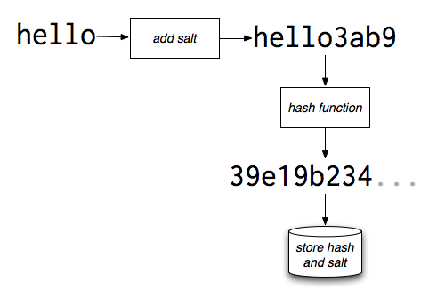
Enter: Salt
Salt protects stored passwords
Salting attempts to defeat a table lookup by adding several characters to the password before hashing it
Characters don’t have to remain secret – though then an attacker could build a table with those characters
Salting thwarts cracking techniques that rely on rainbow tables
Keys to using salt:
Don’t reuse salt - make it different for all users
Don’t use short salt – make it lengthy to make brute forcing difficult

Slide 24
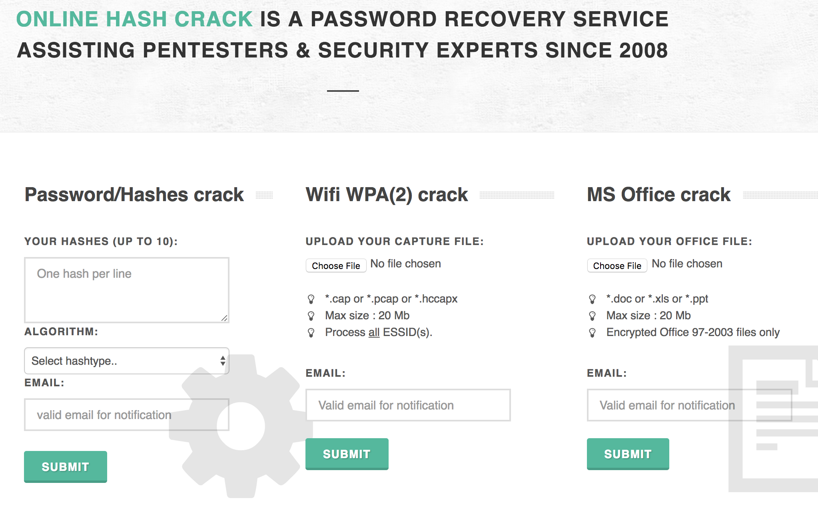
Password Cracking – another option
onlinehashcrack.com

Slide 25
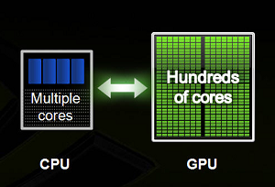
GPU vs. CPU
CPUs have a few cores with lots of cache memory that can handle a few software threads at the same time.
GPUs have hundreds or thousands of cores that handle thousands of threads simultaneously.

Slide 26
GPU vs. CPU
GPUs are highly specialized in number crunching, something that graphics processing desperately needs
Multiple GPUs can be employed for one single task
GPUs are fast, but designed for specific applications.
Number crunching… great for
Hashing
Mining

Slide 27
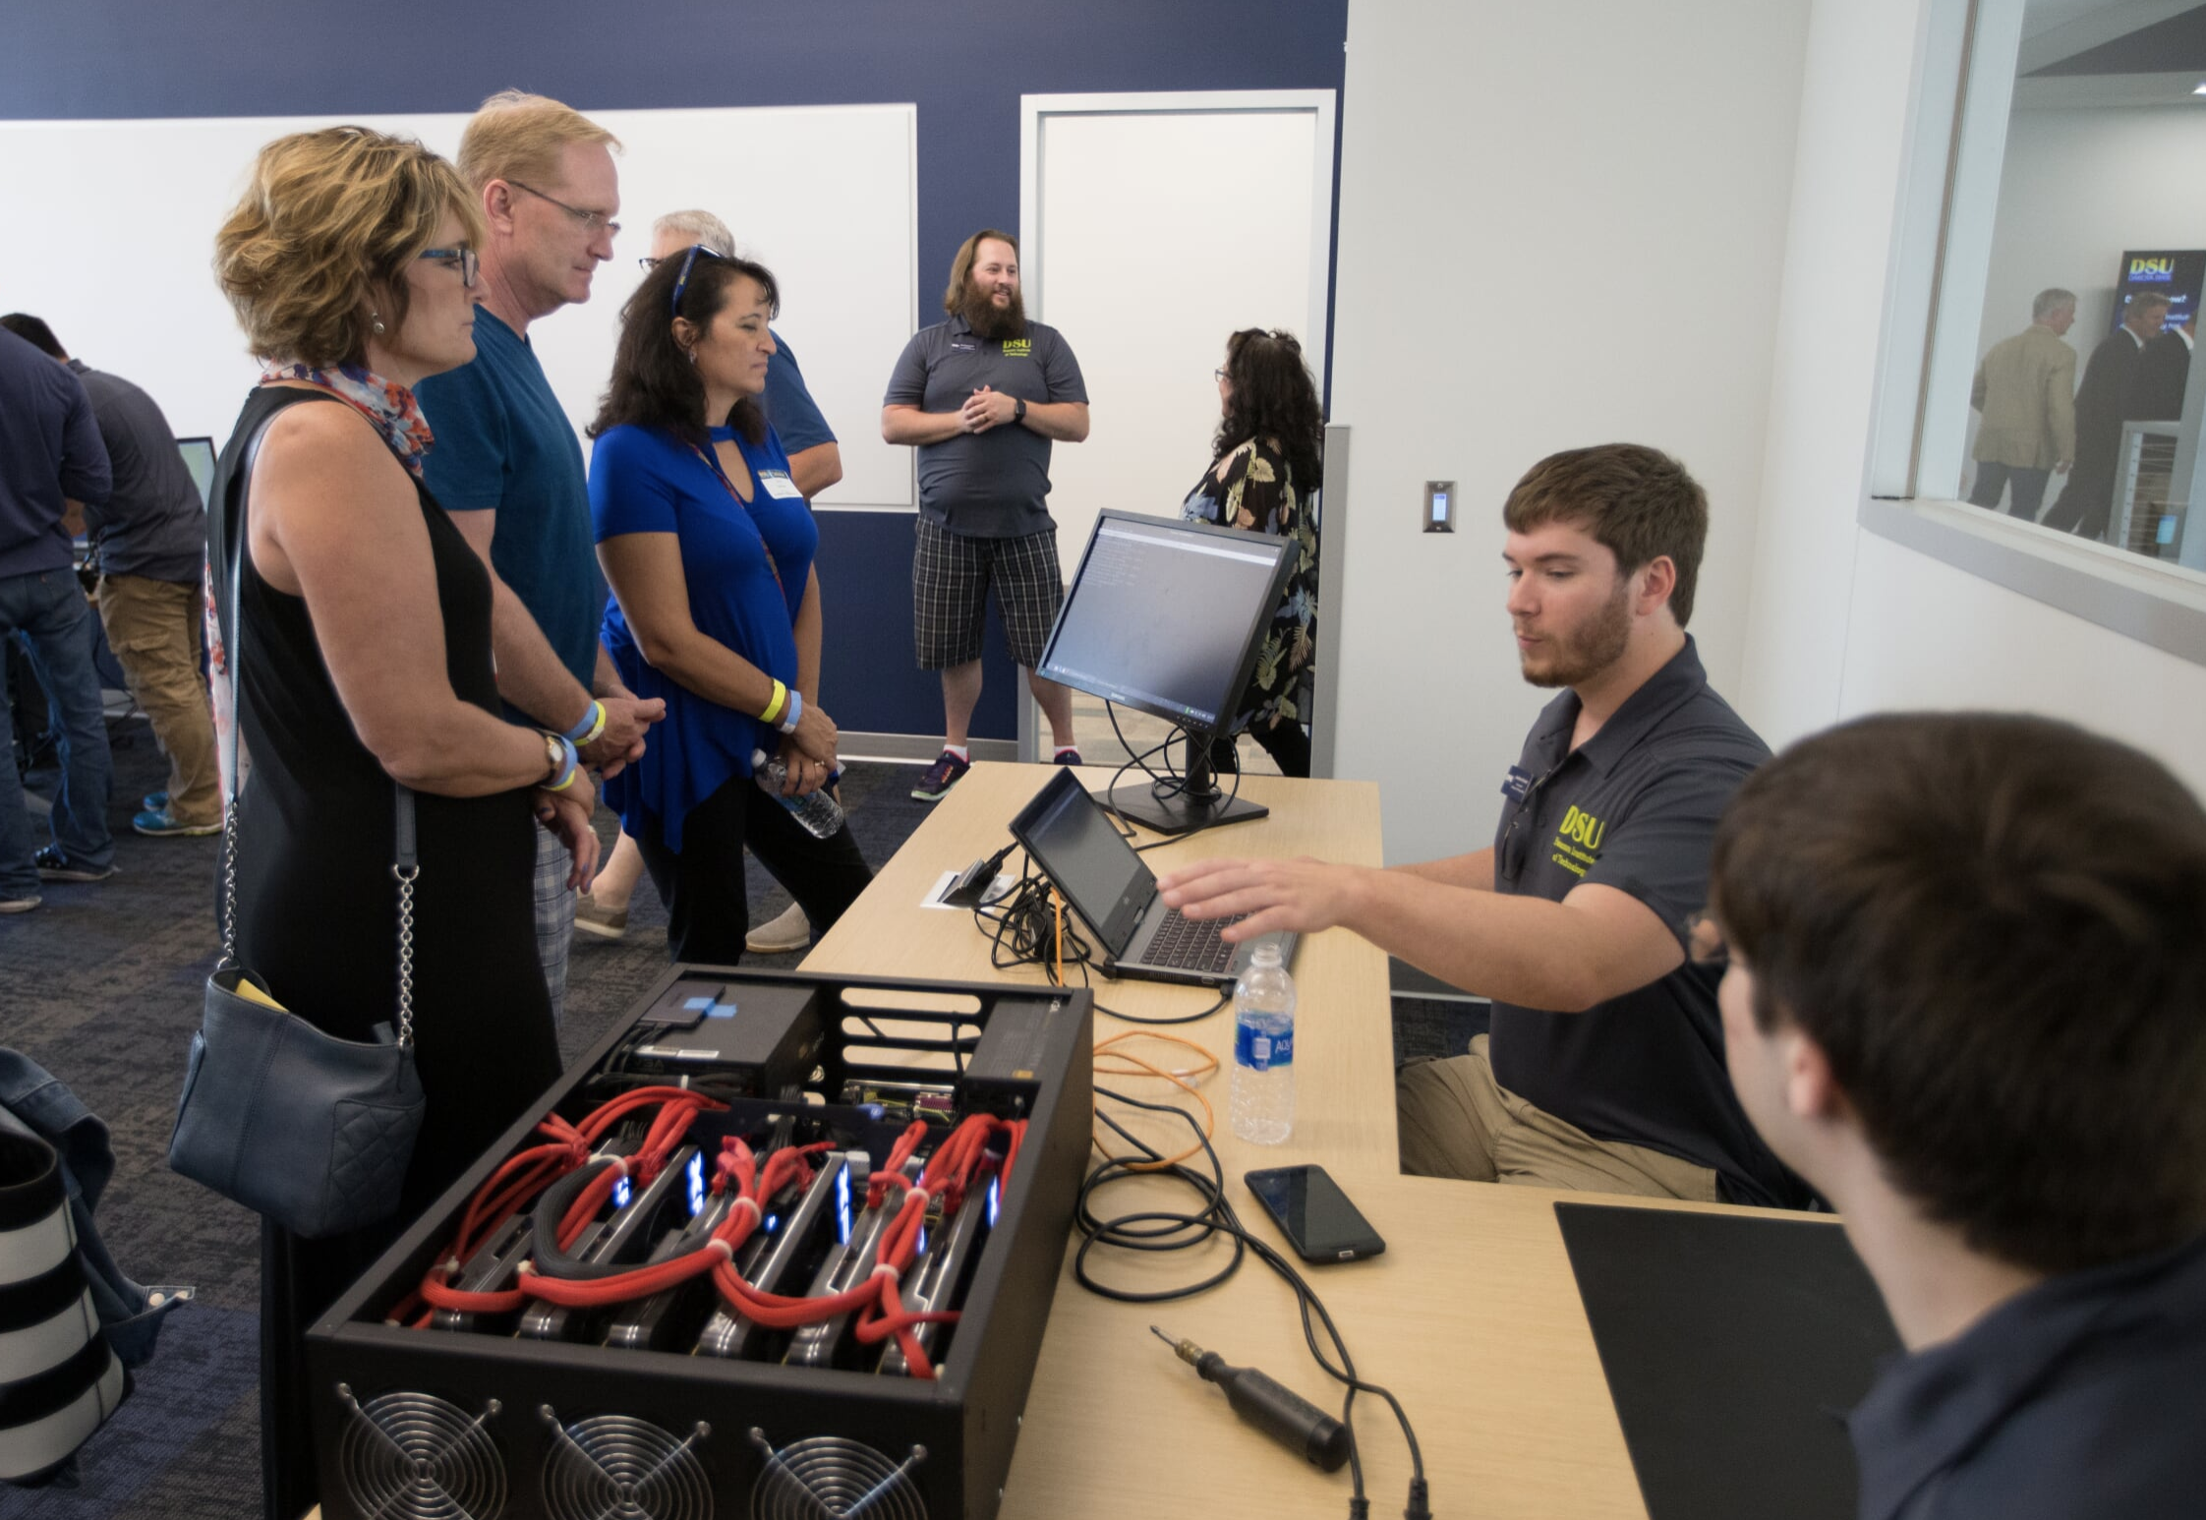

Slide 28
Guessing Passwords?
If we have the hash, we could brute force
Unless if there’s salt – then that’s hard
How about we keep trying passwords right in the login prompt?!?

Slide 29
Guessing Passwords?
If we have the hash, we could brute force
Unless if there’s salt – then that’s hard
How about we keep trying passwords right in the login prompt?!?
Account Lockouts!
Lock the account after a few incorrect login attempts
Stops this method of brute forcing

Slide 30
Passwords
Length is the most important!
Complexity is always good too – but you NEED to remember it
Multi-factor is great, too
Something you know (password)
Something you have (token)
Something you are (biometrics)

Slide 31
What do you think…
Good password?
Bad password?
zc3e1B5873wb#dFE7%kLNWl@knu8Pv$i

Slide 32
What do you think…
Good password?
Bad password?
zc3e1B5873wb#dFE7%kLNWl@knu8Pv$i
I sure can’t remember that…
I would probably have to write it down
BAD!!!!!

Slide 33
XKCD.com

Slide 34
Long Life Passwords at DSU
Requirements:
Minimum of 20 characters long
…that’s it.
Will never expire
Only needs to be changed if there is a compromise of the account

Slide 35
Two Factor Authentication
This can make gaining access to your account really hard
Something you know
Something you have
Something you are
What sites support multi factor auth?
twofactorauth.org

Slide 36
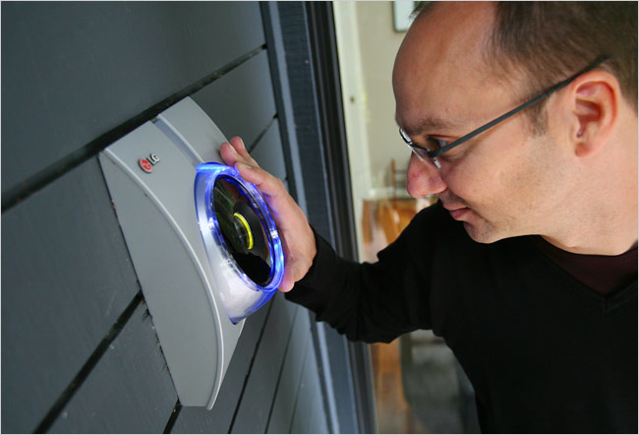
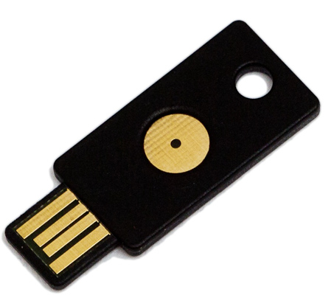
Two Factor Authentication
Something you know
Something you have
Something you are

Slide 37
Bypassing Two Factor Authentication
…any thoughts?

Slide 38
Bypassing Two Factor Authentication
https://techcrunch.com/2018/05/10/hacker-kevin-mitnick-shows-how-to-bypass-2fa/
Social Engineering/Phishing
Domain squatted website
MiTM
Grab session cookie

Slide 39
Getting Creds: Social Engineering
“Gimmie your password, please”
setoolkit

