Slide 1

Recon
DSU GenCyber

Slide 2

Before we start talking about hacking…
This can be you!
This is not you.

Slide 3
White Hat vs. Black Hat
The Good Guys!
Ethical hackers
Use your abilities for good
ONLY operates with permission/approval
Exploits vulnerabilities in systems
Reports findings to organizations, to help better their security posture
Discloses vulnerabilities to developers
The Bad Guys.
Always in the news
Use their abilities for their own personal gain
Operates without permission/approval
Exploits vulnerabilities in systems
Steals valuable information
Sells such information
Disrupting services
Sells vulnerabilities to the highest bidder

Slide 4

Offensive Security Ethics
Don’t do bad stuff
Play nice
ALWAYS gain written permission
Stay legal

Slide 5
Offensive Security Overview
Don’t only the bad guys play the offense?
No!!
“The best defense is a good offense”
Kind of, but not quite…
Goal isn’t to hack the people who are hacking us
BAD IDEA!
Let’s hack our own stuff before someone else does
And fix it!
Need to know how the offense works to be able to do defense well
Offensive Network Security, Penetration Testing
Security Research, Reverse Engineering, Exploitation

Slide 6
Cyber Kill Chain
How an attack works
Learn about the target
Find vulnerabilities
Find weaknesses
Create the exploit
Execute the exploit
Post-Exploitation tasks

Slide 7
PTES
Penetration Testing Execution Standard
Seven main sections
Pre-engagement interactions
Getting the legal documents in place, determining scope, etc.
Intelligence Gathering
Reconnaissance – learning about the target, systems, people
Threat Modeling
Determining highest value assets
Vulnerability Analysis
Finding vulnerabilities in the systems
Exploitation
Taking advantage of the vulnerabilities
Post Exploitation
What do we do once we got in? Move around, find other information, other systems, etc.
Reporting
A test is useless if we can’t tell the customer how we got in, and how to fix it.

Slide 8

Reconnaissance

Slide 9

Reconnaissance
Preliminary surveying or research.
Before we start interacting with the target
What can we learn?
Information gathered during this phase guides the rest of the penetration test
Arguably most important part of Penetration Testing
Example: Bank Robbery
Walk right in “Give me all your money!”
Methodical, planned approach

Slide 10
Recon the Recon
Active vs. Passive
Passive: Not interacting with the target; using information available through other means
Active: Interacting directly with the target
The target may know you are gathering information, or probing their systems
OSINT: Open-Source Intelligence
Publicly available information
Never touching the target

Slide 11
Targeted Data Collection - Business
Details about the business
Who they are
What they do (products/services)
Relationships with other companies
Organizational Chart
Physical Location
Employees
Websites
Usernames
Email Addresses

Slide 12

Your turn!
What can you learn about the following company through open source research on the internet?
Best Buy
Business size
IT size
IT Budget
C-level employees (Chief….)
Services rendered
Partners

Slide 13
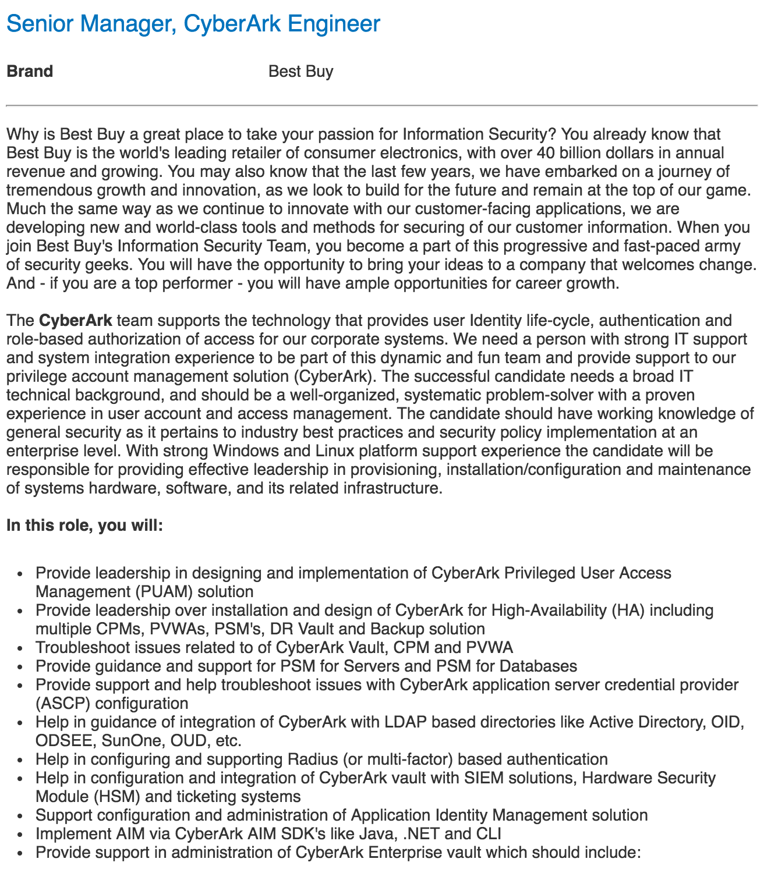
Job Postings
These can be great recon tools for you
Often will list specific technologies in use by the company.
CVE - Common Vulnerabilities and Exposures

Slide 14
Breaking down the recon
Three different major categories
User Recon
Business Recon
Network Recon

Slide 15

User Recon - Phishing
Phishing – attempting to acquire sensitive information by disguising as a trustworthy entity
Often carried out via email
Phishing vs. Spear Phishing
Broad, not targeted phishing
Very specific, targeted phishing

Slide 16
Phishing Example
What’s wrong with this?

Slide 17
Phishing Example
What’s wrong with this?
From jymiller2@gmail.com
Why gmail?
Shouldn’t it be lehigh.edu?
Do you really need to login to remain active?
Best to contact the real Julie to confirm
The link takes you to library.lehigh.saea.ga
What is .ga?
Why not lehigh.edu?

Slide 18
Spearphish Me
Find me (Cody Welu) on Instagram
Using ONLY what I post there, learn about me.
Interests
Where I’ve been/locations
Friends/Family
Anything else interesting?
Draft a spearphishing email to me. Try to get me to click on a link, or open an attachment.
Submit here: http://link.weluc.com/phishCody
Not so great example
Dearest Cody:
Your long lost cousin is actually a Prince with too much money, and it’s your lucky day! Click <here> to claim your payday!

Slide 19
Hi Cody
I noticed your photography online, and I’m looking to hire you for an event. My daughter’s softball club is holding a 2-day tournament in August, and we’d like you to be our official photographer for the event. There are more details about the tournament here: <link>. Please let me know if you’re interested.
Looking forward to hearing back from you!

Slide 20

Could you be phished?
Know what to look for
Be critical of emails, especially attachments and links
Practice good OPSEC
For your safety, security, and wellbeing
What do you want the world to know about you?
Where you work
Where you live
What new expensive toy you got
When you’re on vacation
And not home

Slide 21
Network Recon
Now we’re getting a bit closer to the actual computer systems we’d be attacking
Domain Names
dsu.edu
webmail.dsu.edu
catalog.dsu.edu
IP addresses
Possible usernames
Email addresses
Specific port information

Slide 22
Google-Fu
Google Hacking
Google Dorks
Advanced Search Operators
inurl:
site:
intext:
ext:
https://www.exploit-db.com/google-hacking-database

Slide 23
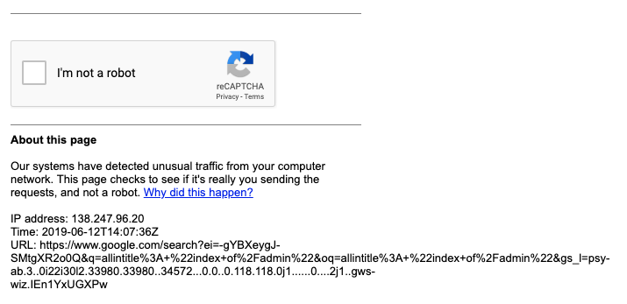
If you search too much…

Slide 24

Tools
Lots of different tools that can help us gather information
All of these are available in Kali Linux
Recon-ng
All sorts of data acquisition tools
Metagoofil
Extracts metadata of documents
Maltego
Good at showing relations between data
Nmap
Network mapping/scanning
Etc….

Slide 25
Info Gathering with Recon-ng
In a terminal, open recon-ng
recon-ng
Create a new workspace and add DSU
workspaces add dsu.edu
add domains dsu.edu
Find some hosts using osint
load netcraft
run
load bing_domain_web
run
load google_site_web
run
load brute_hosts
run
Resolve to IP addresses
load recon/hosts-hosts/resolve
run
load recon/hosts-hosts/reverse_resolve
run
Gather information on contacts (people)
load whois_pocs
run
load pgp_search
run
Generate a nice HTML report of info
use html
set creator YOURNAME
set customer CUSTOMERNAME
run

